Slide 1
Serverless Apps
Pravin Y Pawar

Slide 2
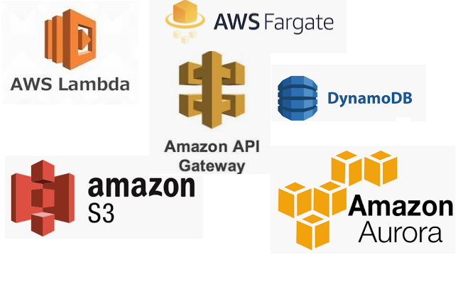
AWS
Serverless Offering
AWS provides a set of fully managed services that can be used to build and run serverless applications
Serverless applications don’t require provisioning, maintaining, and administering servers for backend components such as compute, databases, storage, stream processing, message queueing, and more
No longer need to worry about ensuring application fault tolerance and availability
AWS handles all of these capabilities for applications!
AWS Lambda
Allows to run code without provisioning or managing servers
AWS Fargate
Purpose-built serverless compute engine for containers
Amazon API Gateway
Fully managed service that makes it easy for developers to create, publish, maintain, monitor, and secure APIs at any scale
Source : AWS Serverless

Slide 3
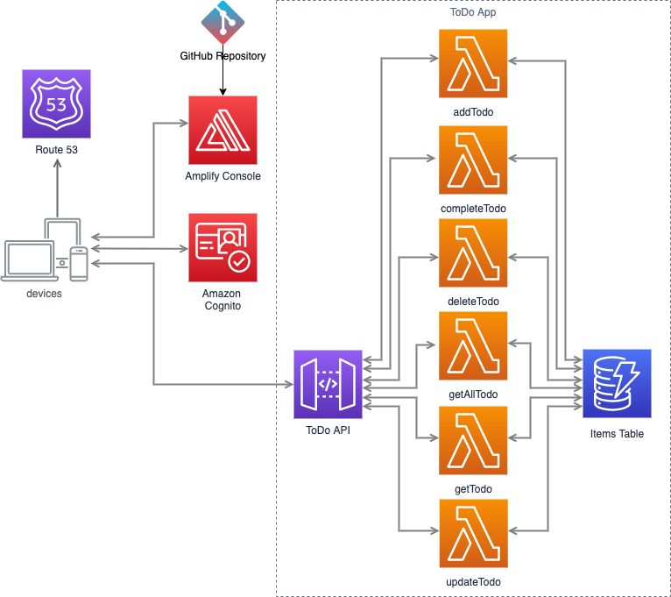
AWS Serverless Architecture
Reference Architecture – Web Application
General-purpose, event-driven, web application back-end that uses
AWS Lambda, Amazon API Gateway for its business logic
Uses Amazon DynamoDB
as its database
Uses Amazon Cognito
for user management
All static content is hosted using AWS Amplify Console
This application implements a simple To Do app, in which a registered user can
create, update, view the existing items, and eventually, delete them
Source : AWS

Slide 4
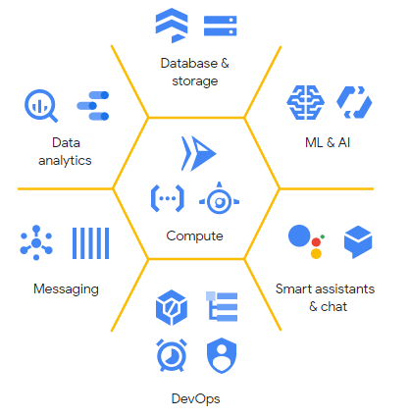
Google Cloud Platform
Serverless computing
Google Cloud’s serverless platform lets you write code your way without worrying about the underlying infrastructure
Deploy functions or apps as source code or as containers
Build full stack serverless applications with Google Cloud’s storage, databases, machine learning, and more
Easily extend applications with event-driven computing from Google or third-party service integrations
You can even choose to move your serverless workloads to on-premises environments or to the cloud
Source : Google Product Page

Slide 5
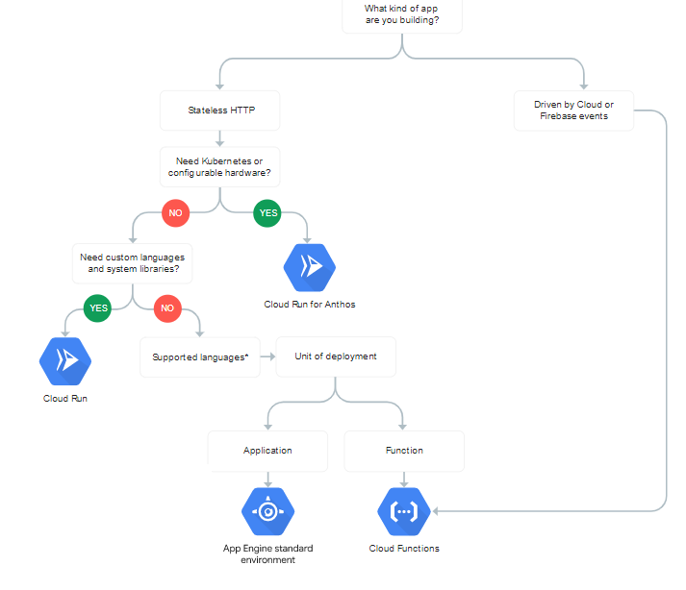
Google Cloud Platform (2)
Services Offered
Cloud Functions
An event-driven compute platform to easily connect and extend Google and third-party cloud services and build applications that scale from zero to planet scale.
App Engine standard environment
A fully managed Serverless application platform for web and API backends. Use popular development languages without worrying about infrastructure management.
Cloud Run
A Serverless compute platform that enables you to run stateless containers invocable via HTTP requests
Cloud Run is available as a fully managed, pay-only-for-what-you-use platform and also as part of Anthos.
Source : Google Product Page

Slide 6
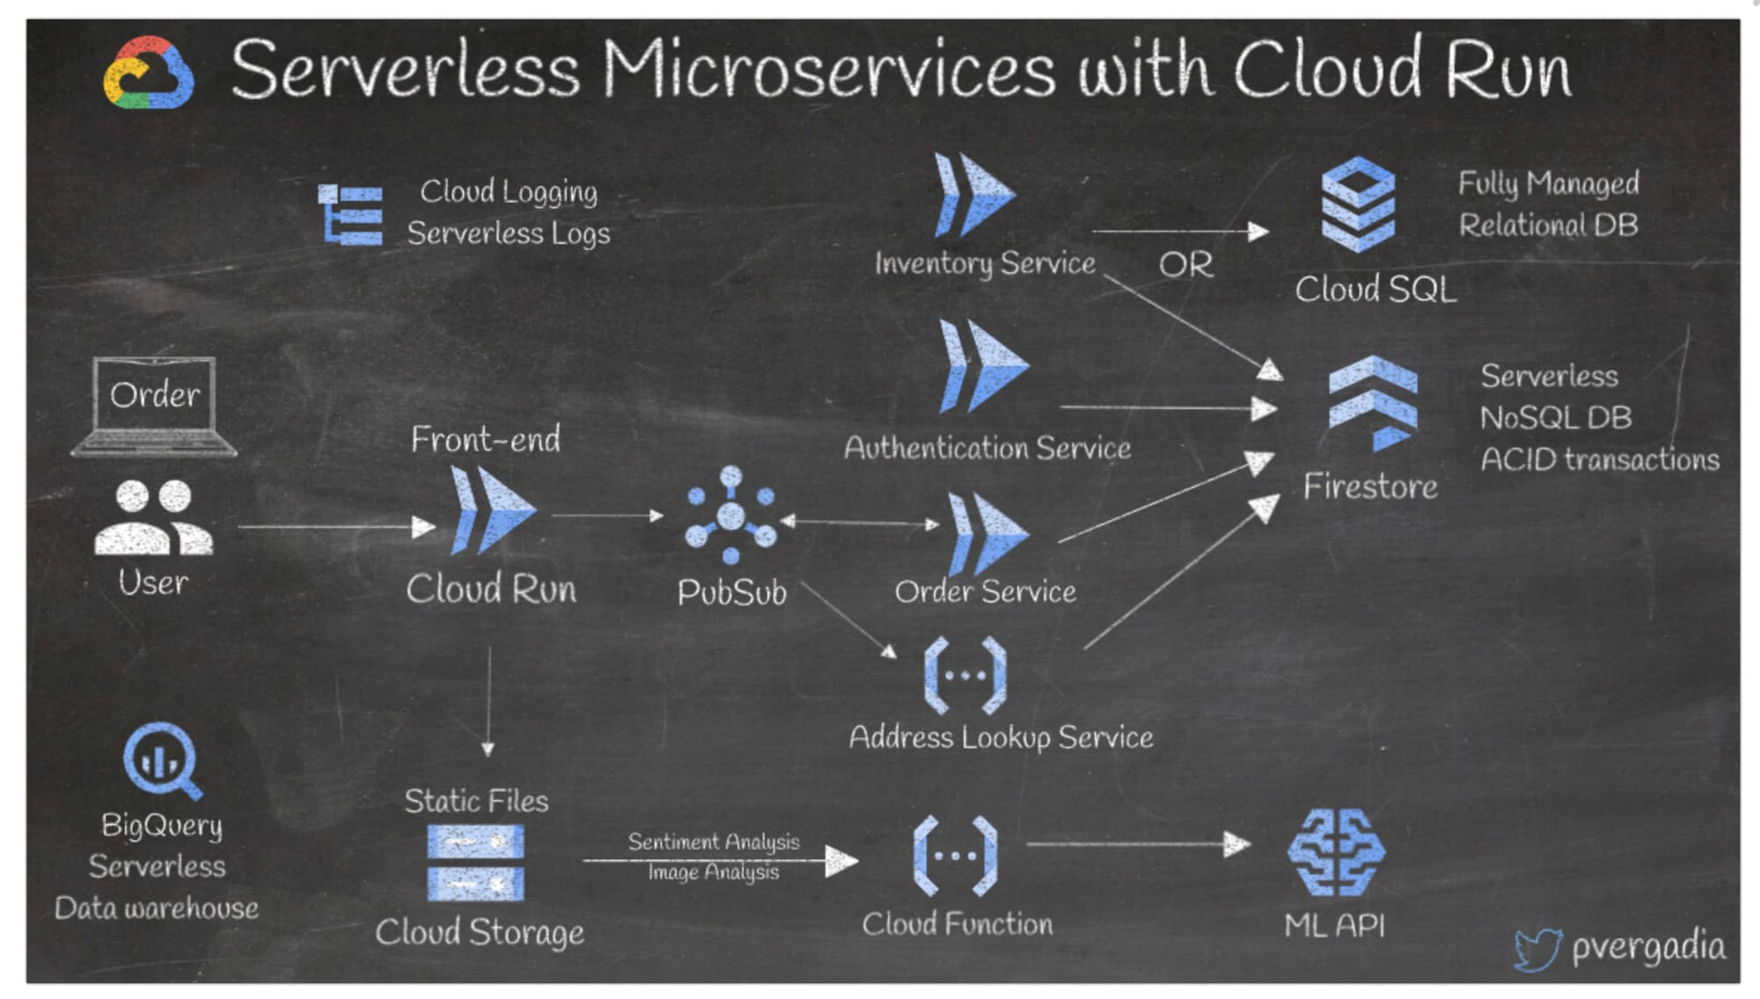
GCP Serverless Architecture
Example – Order Processing
Source : Google

Slide 7
GCP Serverless Architecture (2)
Example - Flow
A good way to build a serverless microservice architecture on Google Cloud is to use Cloud Run.
Example of an e-commerce app:
When a user places an order, a frontend on Cloud Run receives the request and sends it to Pub/Sub, an asynchronous messaging service.
The subsequent microservices, also deployed on Cloud Run, subscribe to the Pub/Sub events.
Let's say the authentication service makes a call to Firestore, a serverless NoSQL document database.
The inventory service queries the DB either in a CloudSQL fully managed relational database or in Firestore
Then the order service receives an event from Pub/Sub to process the order.
The static files are stored in Cloud Storage, which can then trigger a cloud function for data analysis by calling the ML APIs.
There could be other microservices like address lookup deployed on Cloud Functions.
All logs are stored in Cloud Logging.
BigQuery stores all the data for serverless warehousing.

Slide 8
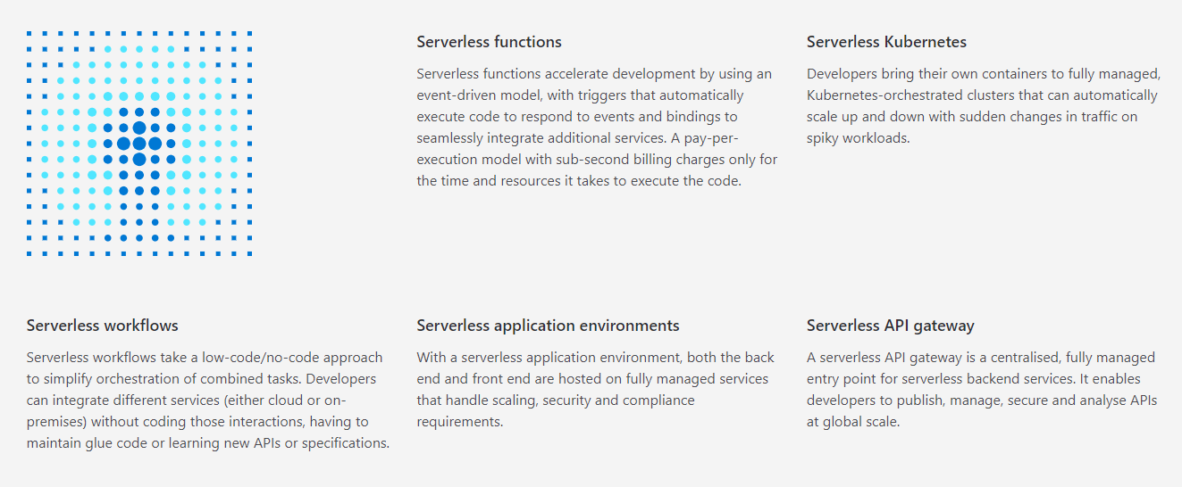
Microsoft Azure
Serverless application patterns
Source : MS Serverless

Slide 9
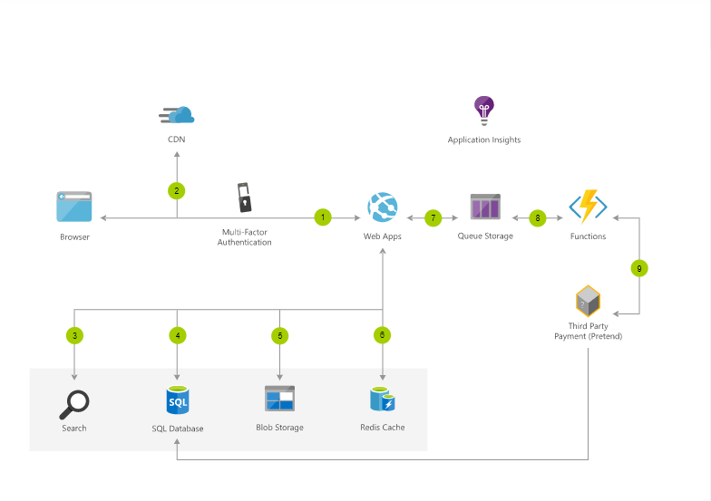
Microsoft Azure Serverless Architecture
Example – Architect scalable e-commerce web app
1 User accesses the web app in browser and signs in.
2 Browser pulls static resources such as images from Azure Content Delivery Network.
3 User searches for products and queries SQL database.
4 Web site pulls product catalog from database.
5 Web app pulls product images from Blob Storage.
6 Page output is cached in Azure Cache for Redis for better performance.
7 User submits order and order is placed in the queue.
8 Azure Functions processes order payment.
9 Azure Functions makes payment to third party and records payment in SQL database.
Source : MS Serverless

Slide 10
Thank You!
In our next session:

